Slide 1

E-commerce Demographics
Customer Lifetime Value
Team 8
Joseph Miguel, Jeremy Grace, Jonathan Hilgart, & Victor Vulovic

Slide 2
Agenda
Customer Lifetime Value
Customer Segmentation
Predict the Value of customers
Conclude with Recommendations

Slide 3
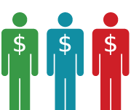
What is Customer Lifetime Value?

Slide 4
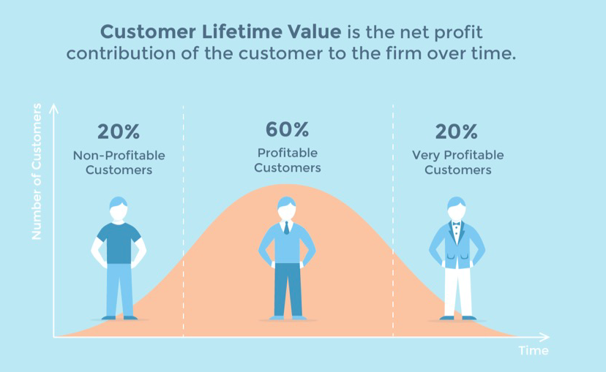
What is Customer Lifetime Value (CLV)?
*https://blog.kissmetrics.com/wp-content/uploads/2016/08/customer-lifetime-value-curve.jpg

Slide 5
Why CLV?
Segmenting customers shows where to dedicate marketing efforts
Indicates the typical purchase cycle for your customers
Can be used to measure the effectiveness of different retention strategies
We will use Markov Chains to determine our customers CLV
One
Two
Churn

Slide 6
CLV Markov Assumptions

Slide 7
Assumptions
Customers have the same transition probability for each combination of frequency and monetary value contribution per recency period.
Customers can only transition from the current state to the next state, or back to recency state one (i.e. a customer made a purchase)
The projections assume no new customers are added

Slide 8
How to Segment Our Users

Slide 9

How should we group our user base?

Slide 10



Recency Frequency and Monetary Value
1) When was the last purchase*
2) How many purchase made
3) Average purchase price
*Recency is the most important variable in this model

Slide 11
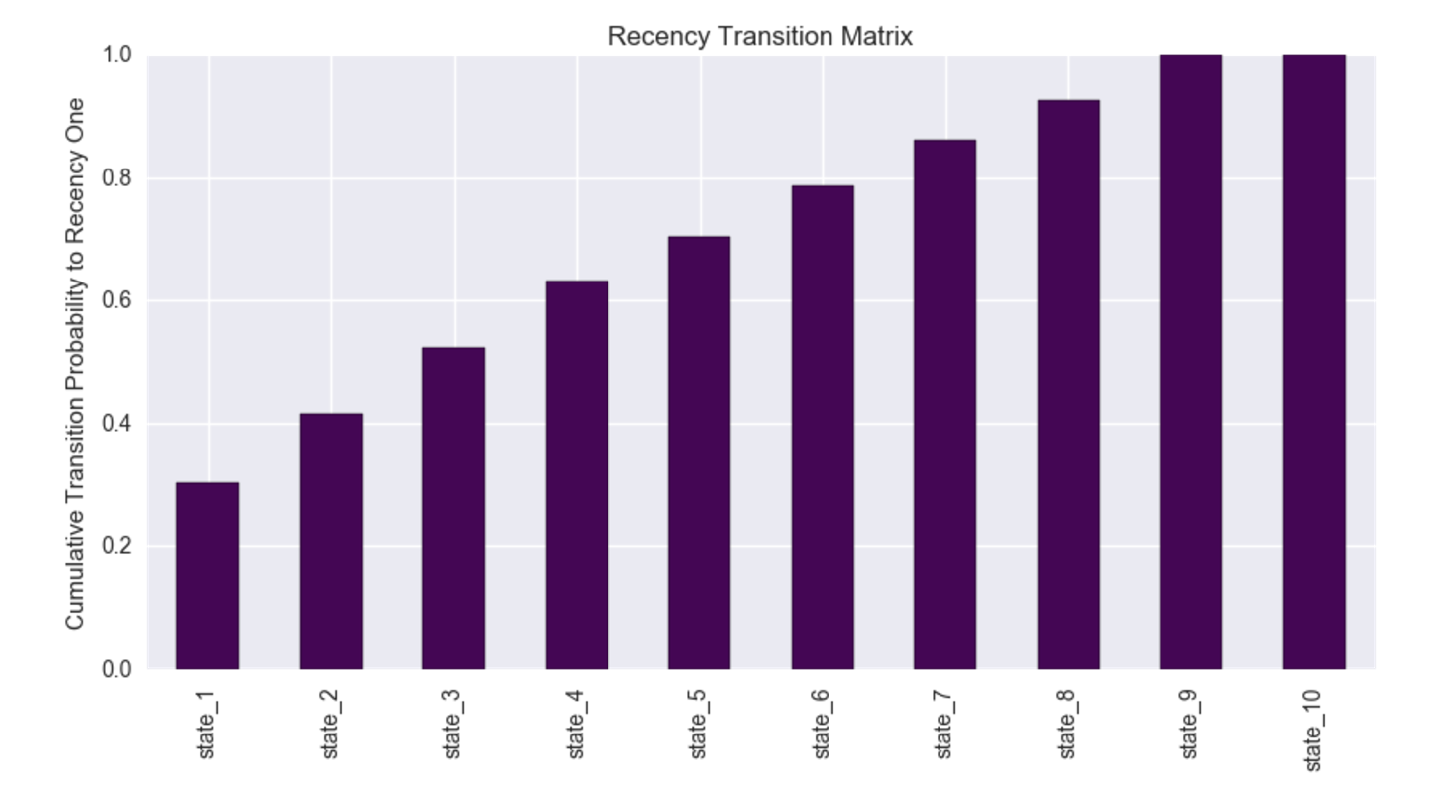
Four Recency Buckets For Customers
1)RFM-recency one
2)RFM-recency two
3)RFM-recency three
4)RFM-Inactive
Last ten years of customer purchase data
States 7-10 have ~20% of transitioning to recency one

Slide 12
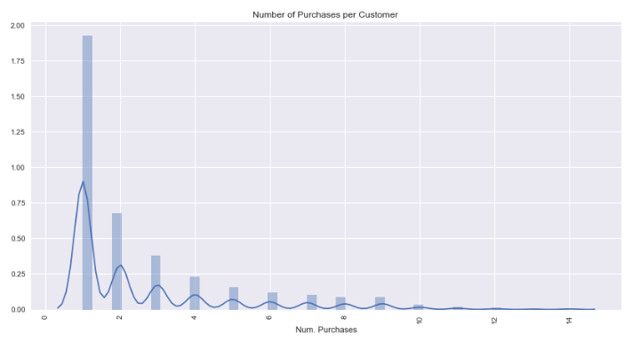
Frequency
How many purchases does each unique customer make?

Slide 13
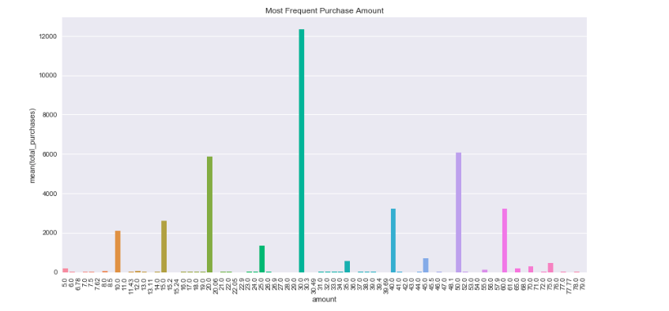
Monetary Value
What is the most frequent ‘basket size’ of our customers

Slide 14



Top Personas
 | VIPs |  | Budget Buyers |  | Wanderers
Recency | <2 | =>2 & <4 | <2 | =>2 & <4 | <2 | =>2 & <4
Frequency | =>2 | =>2 | =>2 | =>2 | <2 | <2
Monetary Value | =>30 | =>30 | <30 | <30 | <30 | <30
% of Customers | 17% | 7.5% | 5% | 3% | 2% | 3%
Average purchase value per person | $86 | $82 | $21 | $20 | $17 | $15
1)
2)
3)

Slide 15
Predict Segment’s CLV

Slide 16
Financial Impact of Each Customer Segment
Probability of each customer transitioning to another state after t years
Expected Revenue per RFM State
Expected revenue per state after t years
X
=

Slide 17
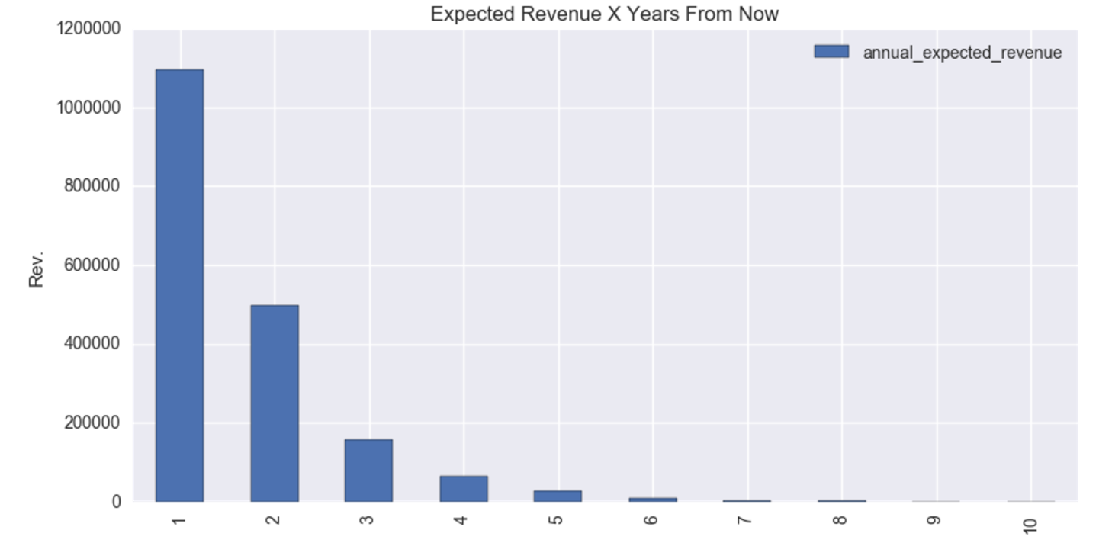
Customer Value in 2025
Total Value:
$1,857,080.48
Discount rate of 10%

Slide 18
Moving Forward

Slide 19
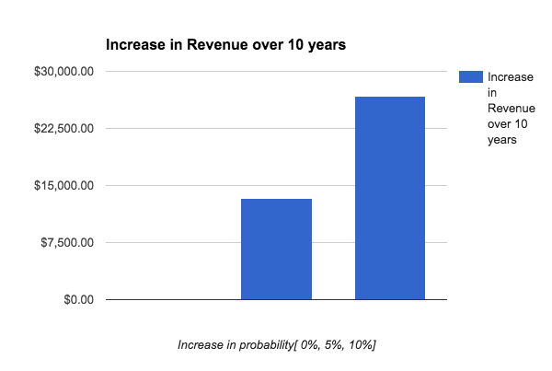
Focus on Most Valuable Customers
Focus on the people most valuable to your company
Increase the probability of VIPs purchasing again
Discount Rate 10%

Slide 20
Recommendations

Slide 21
Conclusion
Due to low frequency of customer purchases, on average two-three per person, and long purchase cycle, a year, most customers churn over the span of ten years
We recommend:
Increase growth efforts to ensure we are finding new customers
Use promotions to encourage people past the three purchase mark, which is when they become the most value to us
Focus on VIPs to increase probability of another purchase

Slide 22
Questions

Slide 23
Appendix

Slide 24
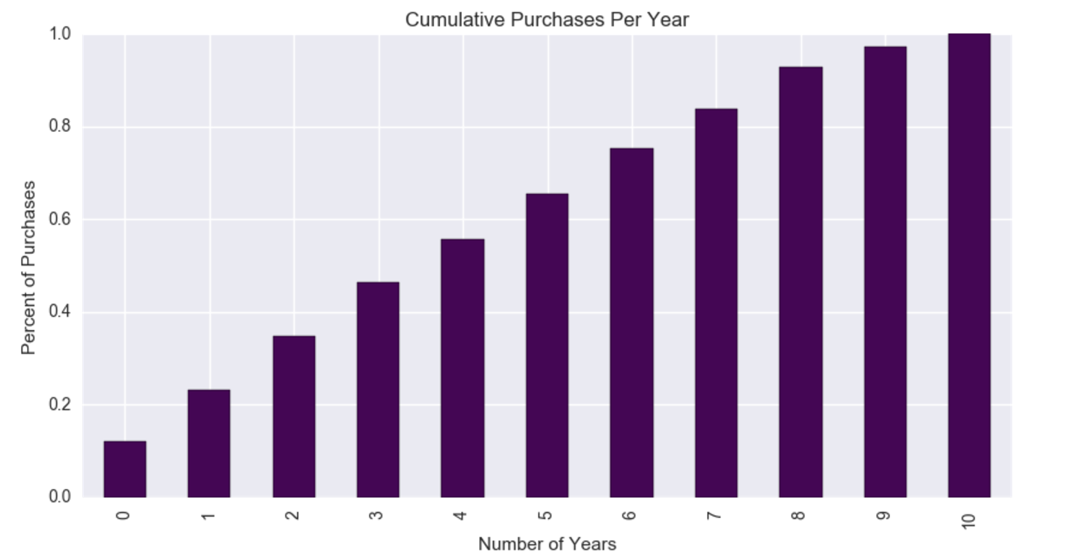
Customer Base Overview
Cut the last two years ( nine and ten)

Slide 25
Our Customer RFM States
`state 1: R < 2, F >=2, MV >=30
state 2: R <2 , F >=2 , MV <30
state 3: R <2 , F <2 , MV <30
state 4: R <2 , F <2 , MV >=30`
`state 5: R >=2-<4, F >=2, MV >=30
state 6: R 2-4, F >=2, MV <30
state 7: R 2-4, F<2, MV <30
state 8: R 2-4, F<2, MV >=30`
`state 9: R >=4-<6, F >=2, MV >=30
state 10: R 4-6, F >=2, MV <30
state 11: R 4-6, F<2, MV <30
state 12: R 4-6, F<2, MV >=30`

Slide 26
Overview of Our Customers
Each customer purchases 3 times from our website on average
Very cyclical purchase pattern
Segmented customers on:
Recency (time since last purchase)
Frequency (number of purchases)
Monetary Value (average value of each customer’s purchase)

Slide 27
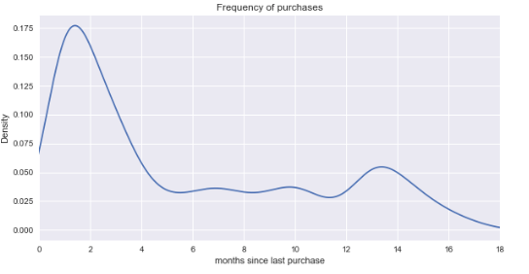
Recency
How long until customers purchase again from us?

Slide 28
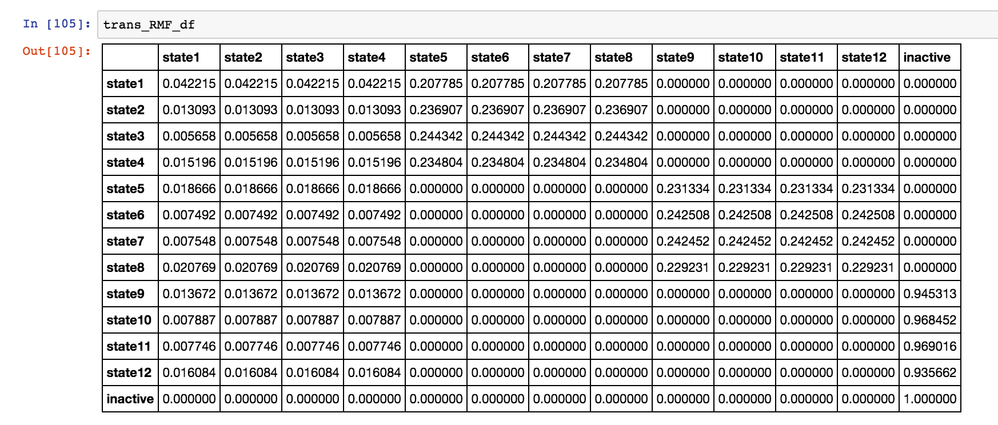
RFM Transition Matrix

